Slide 1

OPEN SOURCE

Slide 2



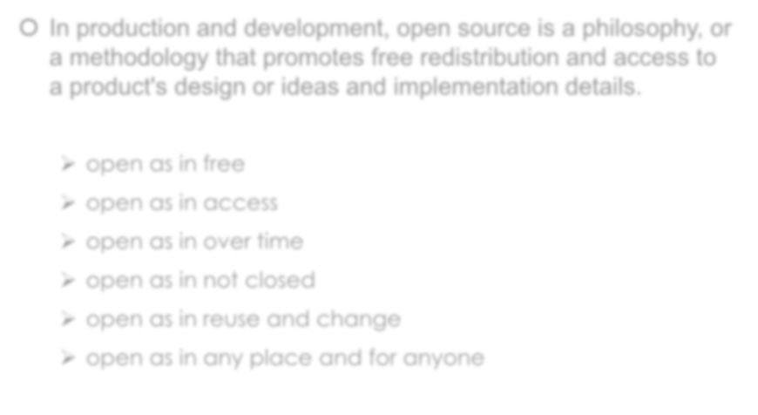

WHAT IS OPEN SOURCE ?
 In production and development, open source is a philosophy, or a methodology that promotes free redistribution and access to a product's design or ideas and implementation details.
open as in free
open as in access
open as in over time
open as in not closed
open as in reuse and change
open as in any place and for anyone

Slide 3





OPEN SOURCE VS. CLOSED SOURCE
 View/Modify the source code of an application or software.
 Open source software is released to the development community and undergoes a secondary phase of
evolution, but closed source software is developed in isolation
with a small team of developers.
 Developer support and large community to help.
 Open Source is more secure and bugs and vulnerabilities are fixed often.

Slide 4

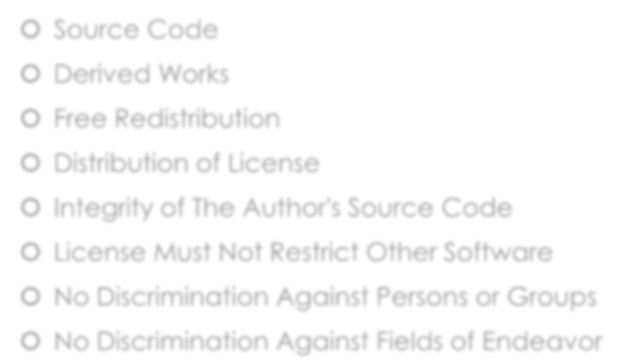

CRITERIA FOR OPEN SOURCE
 Source Code
 Derived Works
 Free Redistribution
 Distribution of License
 Integrity of The Author's Source Code
 License Must Not Restrict Other Software
 No Discrimination Against Persons or Groups
 No Discrimination Against Fields of Endeavor

Slide 5



HISTORY OF OPEN SOURCE
 The concept of free sharing of technological information existed long before computers.
 Similar to open standards, researchers with access to Advanced Research Projects Agency Network (ARPANET) used a process called Request for Comments to develop telecommunication network protocols which led to the birth of the INTERNET in 1969.
 The term Open Source was adopted by a group of people held at Palo Alto, California. "Open Source Summit" organized in April 1998 by technology publisher Tim O'Reilly.

Slide 6


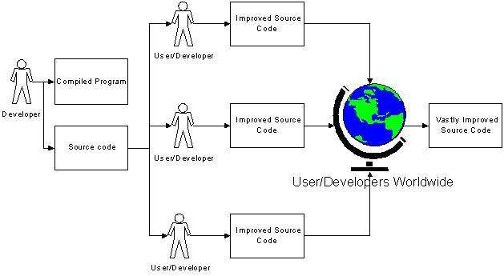
HOW OPEN SOURCE WORKS ?

Slide 7

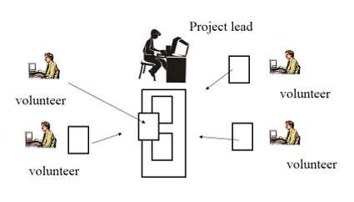
OPEN SOURCE DEVELOPMENT MODEL

Slide 8




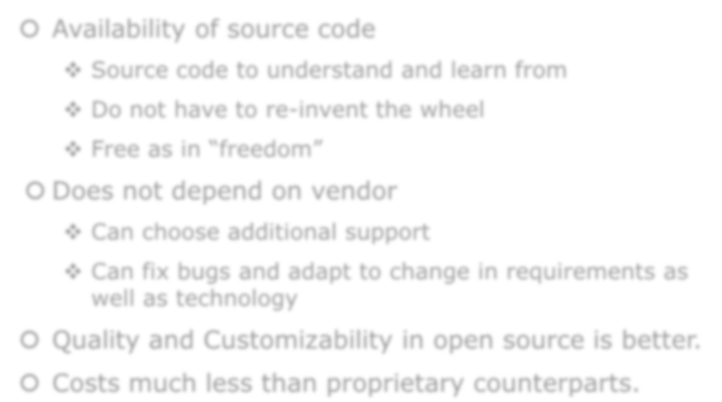
ADVANTAGES OF OPEN SOURCE
 Availability of source code
Source code to understand and learn from
Do not have to re-invent the wheel
Free as in “freedom”
 Does not depend on vendor
Can choose additional support
Can fix bugs and adapt to change in requirements as well as technology
 Quality and Customizability in open source is better.
 Costs much less than proprietary counterparts.

Slide 9



SOME DISADVANTAGES OF OPEN SOURCE
 Not generally straightforward to use and requires a certain learning curve to use and get accustomed.
 Incompatibility issue with software and hardware. (3rd party drivers)
 Bad Codes, and some unqualified people who uses it.
 Software quality assurance process is widely not transparent
 No financial incentive.

Slide 10


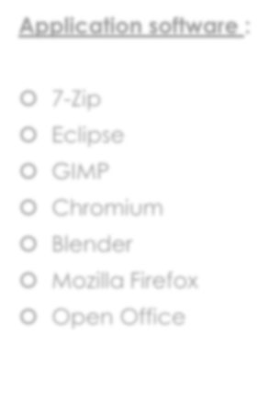
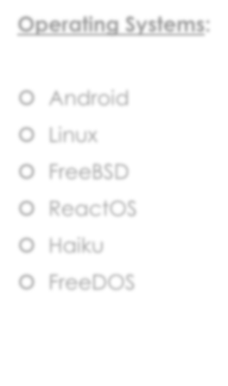
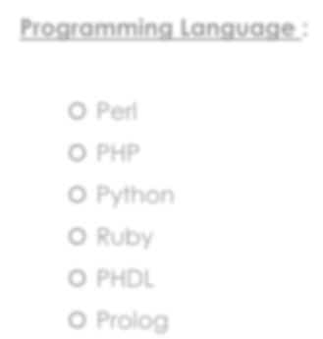


EXAMPLES OF OPEN SOURCE
Application software :
Operating Systems:
Programming Language :
 7-Zip
 Eclipse
 GIMP
 Chromium
 Blender
 Mozilla Firefox
 Open Office
 Android
 Linux
 FreeBSD
 ReactOS
 Haiku
 FreeDOS
 Perl
 PHP
 Python
 Ruby
 PHDL
 Prolog

Slide 11

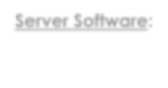

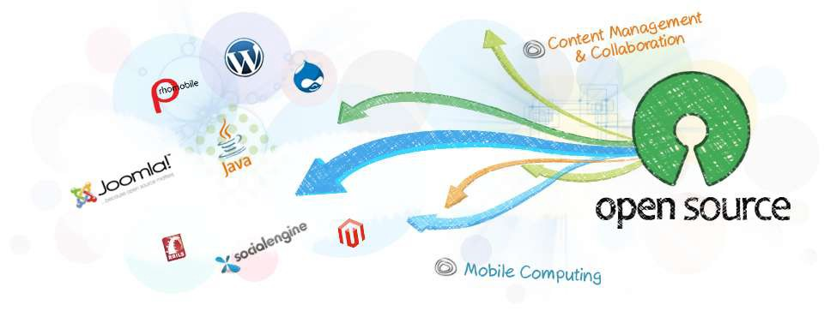
EXAMPLES OF OPEN SOURCE
Server Software:

Slide 12



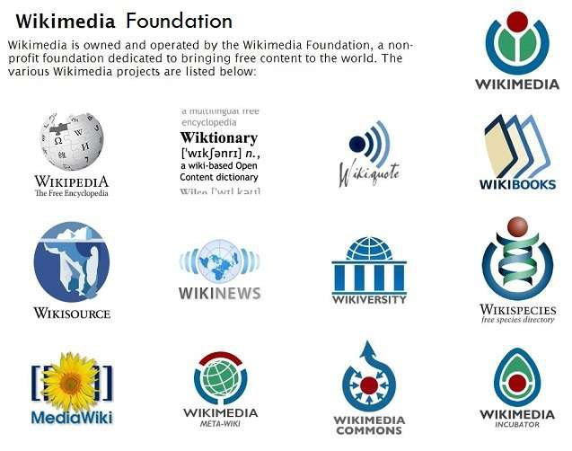



OPEN SOURCE DIGITAL CONTENT

Slide 13





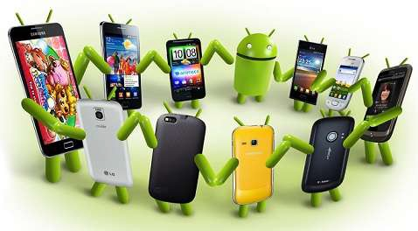
MORE EXAMPLES- ANDROID
 Linux-based operating system designed primarily for touchscreen mobile devices such as smartphones and tablet computers.
 Android is open source and Google releases the code under the
Apache License after acquiring it from Android Inc.
 Most widely used mobile platform with over 7,00,000 apps in google play store, over 25 billion app downloads with 750 million devices running on Android.
 Android Source Code Available at : http://source.android.com/

Slide 14



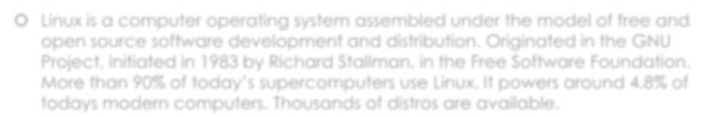
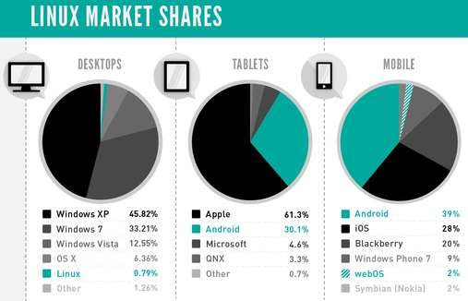

MORE EXAMPLES - LINUX
 Linux is a computer operating system assembled under the model of free and open source software development and distribution. Originated in the GNU Project, initiated in 1983 by Richard Stallman, in the Free Software Foundation. More than 90% of today’s supercomputers use Linux. It powers around 4.8% of todays modern computers. Thousands of distros are available.

Slide 15


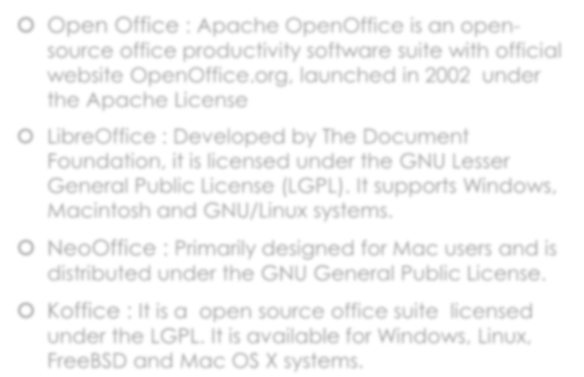




OPEN SOURCE OFFICE SOFTWARES
 Open Office : Apache OpenOffice is an open- source office productivity software suite with official website OpenOffice.org, launched in 2002 under the Apache License
 LibreOffice : Developed by The Document Foundation, it is licensed under the GNU Lesser General Public License (LGPL). It supports Windows, Macintosh and GNU/Linux systems.
 NeoOffice : Primarily designed for Mac users and is distributed under the GNU General Public License.
 Koffice : It is a open source office suite licensed under the LGPL. It is available for Windows, Linux, FreeBSD and Mac OS X systems.

Slide 16



LICENSE AND COPYRIGHTS
 There are hundreds of different licenses.
 Author chooses to license under a licence granting open source freedoms. Some are easy to comply with like :
 “You can do anything you like with this software, as long as you buy me a drink sometime if we meet”.
 Some licenses are more difficult to comply with :
 GNU GPL says that you can only use GPL code if modified/distributed code is also released under the GPL
 “Copyleft”

Slide 17
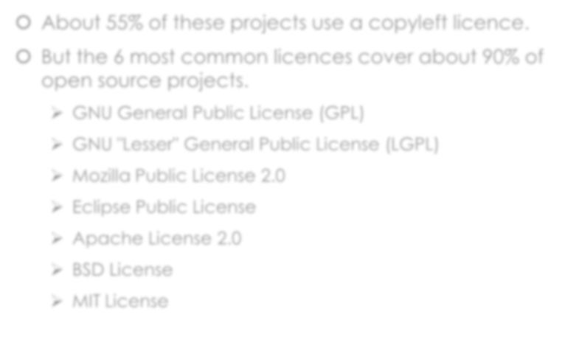

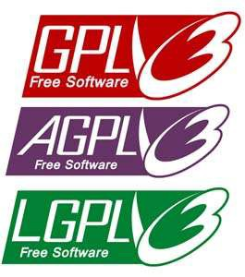
LICENSE AND COPYRIGHTS
 About 55% of these projects use a copyleft licence.
 But the 6 most common licences cover about 90% of open source projects.
GNU General Public License (GPL)
GNU "Lesser" General Public License (LGPL)
Mozilla Public License 2.0
Eclipse Public License
Apache License 2.0
BSD License
MIT License

Slide 18



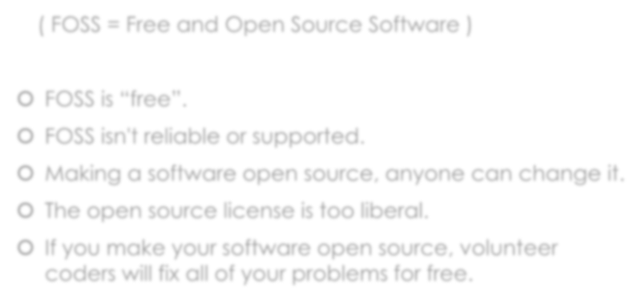
MYTHS ABOUT OPEN SOURCE
( FOSS = Free and Open Source Software )
 FOSS is “free”.
 FOSS isn't reliable or supported.
 Making a software open source, anyone can change it.
 The open source license is too liberal.
 If you make your software open source, volunteer coders will fix all of your problems for free.

Slide 19

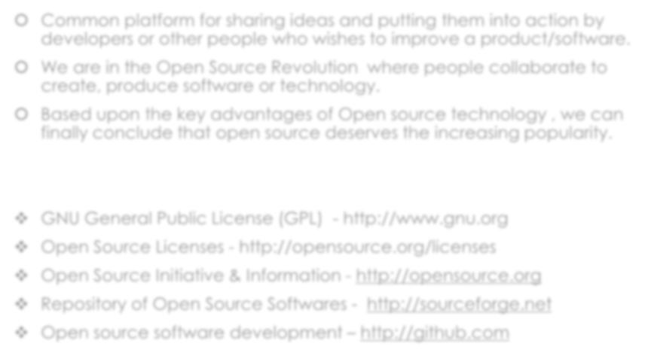


CONCLUSION
 Common platform for sharing ideas and putting them into action by developers or other people who wishes to improve a product/software.
 We are in the Open Source Revolution where people collaborate to
create, produce software or technology.
 Based upon the key advantages of Open source technology , we can finally conclude that open source deserves the increasing popularity.
GNU General Public License (GPL) - http://www.gnu.org
Open Source Licenses - http://opensource.org/licenses
Open Source Initiative & Information - http://opensource.org
Repository of Open Source Softwares - http://sourceforge.net
Open source software development – http://github.com

Slide 20


THANK YOU

